Slide 1
Python Crash Course Databases

Slide 2
Relational Databases
Relational databases model data by storing rows and columns in tables. The power of the relational database lies in its ability to efficiently retrieve data from those tables and in particular where there are multiple tables and the relationships between those tables involved in the query.
http://en.wikipedia.org/wiki/Relational_database

Slide 3
Terminolgy
Database - Contains many tables
Relation (or table) - contains tuples and attributes
Tuple (or row) - is a set of fields it generally represents an “object” like a person or a music track
Attribute (also column or field) - One of possibly many elements of data corresponding to the object represented by the row

Slide 4
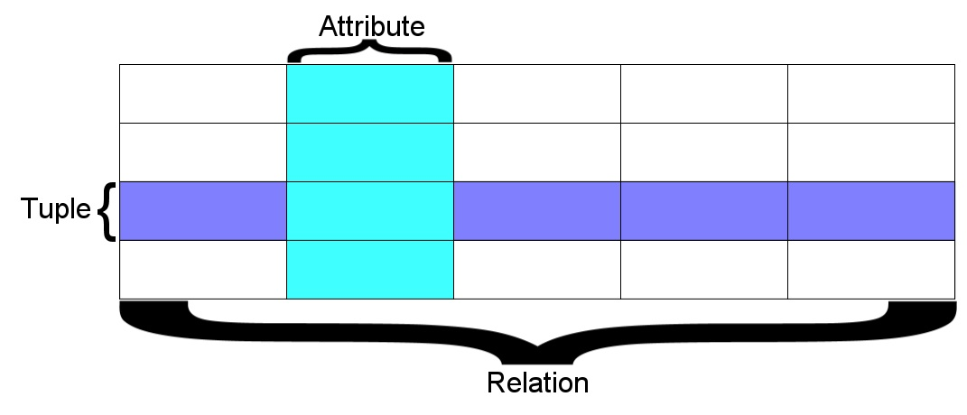
A relation is defined as a set of tuples that have the same attributes.
A tuple usually represents an object and information about that object. Objects are typically physical objects or concepts.
A relation is usually described as a table, which is organized into rows and columns. All the data referenced by an attribute are in the same domain and conform to the same constraints. (wikipedia)

Slide 5
Two roles in large projects
Application Developer - Builds the logic for the application, the look and feel of the application - monitors the application for problems
Database Administrator - Monitors and adjusts the database as the program runs in production
Often both people participate in the building of the “Data model”

Slide 6

Application Structure
Application
Software
Database
Data Model
End
User
SQL
SQL
Developer
Database
Tools
DBA

Slide 7
Database Administrator (dba)
A database administrator (DBA) is a person responsible for the design, implementation, maintenance and repair of an organization's database. The role includes the development and design of database strategies, monitoring and improving database performance and capacity, and planning for future expansion requirements. They may also plan, co-ordinate and implement security measures to safeguard the database.
http://en.wikipedia.org/wiki/Database_administrator

Slide 8
Database Model
A database model or database schema is the structure or format of a database, described in a formal language supported by the database management system, In other words, a "database model" is the application of a data model when used in conjunction with a database management system.
http://en.wikipedia.org/wiki/Database_model

Slide 9
SQL
Structured Query Language is the language we use to issue commands to the database
Create a table
Retrieve some data
Insert data
Delete data
http://en.wikipedia.org/wiki/SQL

Slide 10
Common Database Systems
Three Major Database Management Systems in wide use
Oracle - Large, commercial, enterprise-scale, very very tweakable
MySql - Simpler but very fast and scalable - commercial open source
SqlServer - Very nice - from Microsoft (also Access)
Many other smaller projects, free and open source
HSQL, SQLite, Postgress, ...

Slide 11
SQLite Database Browser
SQLite is a very popular database - it is free and fast and small
We have a program to manipulate SQLite databases
http://sqlitebrowser.org/
SQLite is embedded in Python and a number of other languages

Slide 12
SQLite from python
>>> import sqlite3
>>> sqlite3.version
'2.6.0'
>>>
$ sqlite3
SQLite version 3.7.13 2012-06-11 02:05:22
Enter ".help" for instructions
Enter SQL statements terminated with a ";"
sqlite> .tables
sqlite> .exit
$ ls my.db
my.db

Slide 13
SQLite from python
import sqlite3 as lite
import sys
con = None
try:
con = lite.connect(‘my.db')
cur = con.cursor()
cur.execute('SELECT SQLITE_VERSION()')
data = cur.fetchone()
print "SQLite version: %s" % data
except lite.Error, e:
print "Error %s:" % e.args[0]
sys.exit(1)
finally:
if con:
con.close()

Slide 14
SQL
Structured Query Language is the language we use to issue commands to the database
Create a table
Retieve some data
Insert data
Delete data
http://en.wikipedia.org/wiki/SQL

Slide 15
SQL create
CREATE TABLE My_table(
my_field1 INT,
my_field2 VARCHAR(50),
my_field3 DATE NOT NULL,
PRIMARY KEY (my_field1, my_field2)
);
import sqlite3 as lite
import sys
con = lite.connect('my.db')
with con:
cur = con.cursor()
cur.execute("CREATE TABLE Stars(Ra FLOAT, Dec FLOAT, ID TEXT, Mag FLOAT)")
sqlite3 my.db
SQLite version 3.7.13 2012-06-11 02:05:22
Enter ".help" for instructions
Enter SQL statements terminated with a ";"
sqlite> .tables
Stars
sqlite>

Slide 16
SQL insert
import sqlite3 as lite
import sys
con = lite.connect('my.db')
with con:
cur = con.cursor()
cur.execute(“INSERT INTO Stars VALUES(010.684737,+41.269035,’00424433+4116085’,9.453)”)
cur.execute(“INSERT INTO Stars VALUES(010.683469,+41.268585,’00424403+4116069’,9.321)”)
cur.execute(“INSERT INTO Stars VALUES(010.685657,+41.269550,’00424455+4116103’,10.773)”)
cur.execute(“INSERT INTO Stars VALUES(010.686026,+41.269226,’00424464+4116092’,9.299)”)
cur.execute(“INSERT INTO Stars VALUES(010.683465,+41.269676,’00424403+4116108’,11.507)”)
cur.execute(“INSERT INTO Stars VALUES(010.686015,+41.269630,’00424464+4116106’,9.399)”)
cur.execute(“INSERT INTO Stars VALUES(010.685270,+41.267124,’00424446+4116016’,12.070)”)

Slide 17
SQL Insert
import sqlite3 as lite
import sys
Stars = (
(010.684737,+41.269035,'00424433+4116085',9.453)"),
(010.683469,+41.268585,'00424403+4116069',9.321)"),
(010.685657,+41.269550,'00424455+4116103',10.773)"),
(010.686026,+41.269226,'00424464+4116092',9.299)"),
(010.683465,+41.269676,'00424403+4116108',11.507)"),
(010.686015,+41.269630,'00424464+4116106',9.399)"),
(010.685270,+41.267124,'00424446+4116016',12.070)")
)
con = lite.connect('test.db')
with con:
cur = con.cursor()
cur.execute("DROP TABLE IF EXISTS Stars")
cur.execute("CREATE TABLE Cars(Ra FLOAT, Dec FLOAT INT, ID TEXT, Mag FLOAT)")
cur.executemany("INSERT INTO Stars VALUES(?, ?, ?, ?)", stars)

Slide 18
SQL Select
sqlite3 my.db
SQLite version 3.7.13 2012-06-11 02:05:22
Enter ".help" for instructions
Enter SQL statements terminated with a ";"
sqlite> .mode column
sqlite> .headers on
sqlite> SELECT * from Stars;
Id Ra Dec Mag
---------- ---------- ---------------- ----------
10.684737 41.269035 00424433+4116085 9.453
10.683469 41.268585 00424403+4116069 9.321
10.685657 41.26955 00424455+4116103 10.773
10.686026 41.269226 00424464+4116092 9.299
10.683465 41.269676 00424403+4116108 11.507
10.686015 41.26963 00424464+4116106 9.399
10.68527 41.267124 00424446+4116016 12.07
sqlite>

Slide 19
SQL Select
import sqlite3 as lite
import sys
con = lite.connect(‘my.db')
with con:
cur = con.cursor()
cur.execute("SELECT * FROM Stars")
rows = cur.fetchall()
for row in rows:
print row
<sqlite3.Cursor object at 0x7ff500415650>
(u'10.684737', 41.269035, u'00424433+4116085', 9.453)
(u'10.683469', 41.268585, u'00424403+4116069', 9.321)
(u'10.685657', 41.26955, u'00424455+4116103', 10.773)
(u'10.686026', 41.269226, u'00424464+4116092', 9.299)
(u'10.683465', 41.269676, u'00424403+4116108', 11.507)
(u'10.686015', 41.26963, u'00424464+4116106', 9.399)
(u'10.68527', 41.267124, u'00424446+4116016', 12.07)

Slide 20
SLQ Select where
The select statement retrieves a group of records - you can either retrieve all the records or a subset of the records with a WHERE clause
select * from Stars
select * from Stars where ID=‘00424403+4116108’
You can add an ORDER BY clause to SELECT statements to get the results sorted in ascending or descending order
select * from Stars order by Mag
select * from Stars order by Ra DESC

Slide 21
SQL Update. Delete
Update:
update Stars set ID=‘bogus’ where Mag=10.7
Delete:
Delete from Stare where Mag=10.7

Slide 22
Complex data models and Relations
Database Design
Database design is an art form of its own with particular skills and experience
Our goal is to avoid the really bad mistakes and design clean and easily understood databases
Others may performance tune things later
Database design starts with a picture...

Slide 23
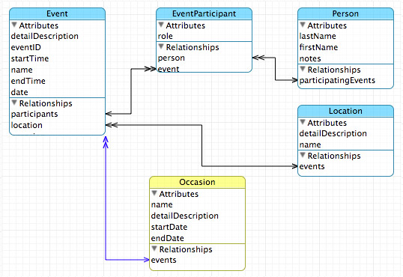
Database Design

Slide 24
Building a Data Model
Drawing a picture of the data objects for our application and then figuring out how to represent the objects and their relationships
Basic Rule: Don’t put the same string data in twice - use a relationship instead
When there is one thing in the “real world” there should be one copy of that thing in the database

Slide 25
For each “piece of info”
Is the column an object or an attribute of another object?
Once we define objects we need to define the relationships between objects.
Star
Mag
Class
Cluster
Publication

Slide 26
Entity and Relations
Star
Mag
has
Publication
belongs to
is of
Class
Cluster

Slide 27
Three kinds of keys
Primary key - generally an integer auto-increment field
Logical key - What the outside world uses for lookup
Foreign key - generally an integer key point to a row in another table
Star
ID
Name
pub_id

Slide 28
Foreign Keys
A foreign key is when a table has a column that contains a key which points the primary key of another table.
When all primary keys are integers, then all foreign keys are integers - this is good - very good
If you use strings as foreign keys - you show yourself to be an uncultured swine
Star
ID
Name
pub_id
class_id
…
Publication
ID
Volume
Authors
Pages
…
Class
ID
Surf Temp
Luminosity
Mass
...

Slide 29
SQLITE
sqlite3 my.db
SQLite version 3.7.13 2012-06-11 02:05:22
Enter ".help" for instructions
Enter SQL statements terminated with a ";"
sqlite> create table Publication(ID integer primary key autoincrement, Vol int, Pages int);
sqlite> insert into Publication(Vol, Pages) VALUES (10,22);
sqlite> select * from Publication;
ID Vol Pages
---------- ---------- ----------
1 10 22
sqlite> insert into Publication(Vol, Pages) VALUES (11,25);
sqlite> select * from Publication;
ID Vol Pages
---------- ---------- ----------
1 10 22
2 11 25

Slide 30
SQL Select
>>> import sqlite3 as lite
>>> import sys
>>>
>>> con = lite.connect('my.db')
>>>
>>> with con:
... cur = con.cursor()
... cur.execute("SELECT * FROM Publication")
... rows = cur.fetchall()
... for row in rows:
... print row
...
<sqlite3.Cursor object at 0x7fadfa86c650>
(1, 10, 22, ‘Deul,Mulish’)
(2, 11, 25, ‘Deen,Carmen’)
>>>

Slide 31
SQL Select
>>> import sqlite3 as lite
>>> import sys
>>>
>>> con = lite.connect('my.db')
>>>
>>> with con:
... cur = con.cursor()
... cur.execute("SELECT Authors FROM Publication WHERE Authors LIKE ‘%Deu%’")
... rows = cur.fetchall()
... for row in rows:
... print row
...
<sqlite3.Cursor object at 0x7fadfa86c650>
(u'Deul,Mulish',)
>>>

Slide 32
SQLITE build relations
sqlite3 my.db
SQLite version 3.7.13 2012-06-11 02:05:22
Enter ".help" for instructions
Enter SQL statements terminated with a ";"
sqlite> alter table Stars add column pub_id int;
sqlite> .mode columns
sqlite> .header on
sqlite> select * from Stars;
Id Ra Dec Mag pub_id
---------- ---------- ---------------- ---------- ----------
10.684737 41.269035 00424433+4116085 9.453
.
10.686015 41.26963 00424464+4116106 9.399
10.68527 41.267124 00424446+4116016 12.07
sqlite> update Stars Set pub_id=1 where Mag=12.07;
sqlite> select * from Stars;
Id Ra Dec Mag pub_id
---------- ---------- ---------------- ---------- ----------
10.684737 41.269035 00424433+4116085 9.453
.
10.686015 41.26963 00424464+4116106 9.399
10.68527 41.267124 00424446+4116016 12.07 1
sqlite>

Slide 33
Using relations
>>> import sqlite3 as lite
>>> import sys
>>>
>>> con = lite.connect('my.db')
>>>
>>> with con:
... cur = con.cursor()
... cur.execute("SELECT * FROM Stars,Publication where Stars.pub_id=Publication.id")
... rows = cur.fetchall()
... for row in rows:
... print row
...
<sqlite3.Cursor object at 0x7fadfa86c650>
(u'10.68527', 41.267124, u'00424446+4116016', 12.07, 1, 1, 10, 22)
>>>

Slide 34
Dictionary cursor
>>> import sqlite3 as lite
>>> import sys
>>>
>>> con = lite.connect('my.db')
>>>
>>> with con:
... con.row_factory = lite.Row
... cur = con.cursor()
... cur.execute("SELECT * FROM Stars,Publication where Stars.pub_id=Publication.id")
... rows = cur.fetchall()
... for row in rows:
... print "%s %s %s“ % (row[“Mag"], row[“Vol"])
...
<sqlite3.Cursor object at 0x7fadfa86c650>
12.07 10
>>>

Slide 35
JOIN
>>> import sqlite3 as lite
>>> import sys
>>>
>>> con = lite.connect('my.db')
>>>
>>> with con:
... con.row_factory = lite.Row
... cur = con.cursor()
... cur.execute("SELECT Stars.Mag,Publication.Vol FROM Stars JOIN Publication on Stars.pub_id=Publication.id")
... rows = cur.fetchall()
... for row in rows:
... print "%s %s" % (row["Mag"],row["Vol"])
...
<sqlite3.Cursor object at 0x7fb1fe37eb20>
12.07 10
>>>

Slide 36
SQLite Browser
SQLite is a very popular database - it is free and fast and small
SQLite Browser allows us to directly manipulate SQLite files
http://sqlitebrowser.org/
a number of other languages

Slide 37
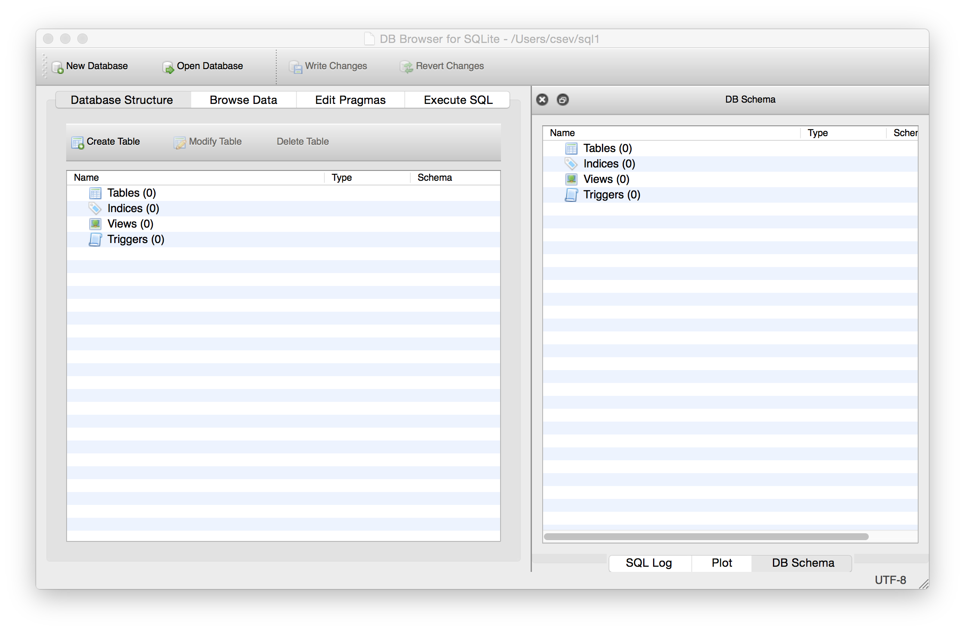
Text

Slide 38
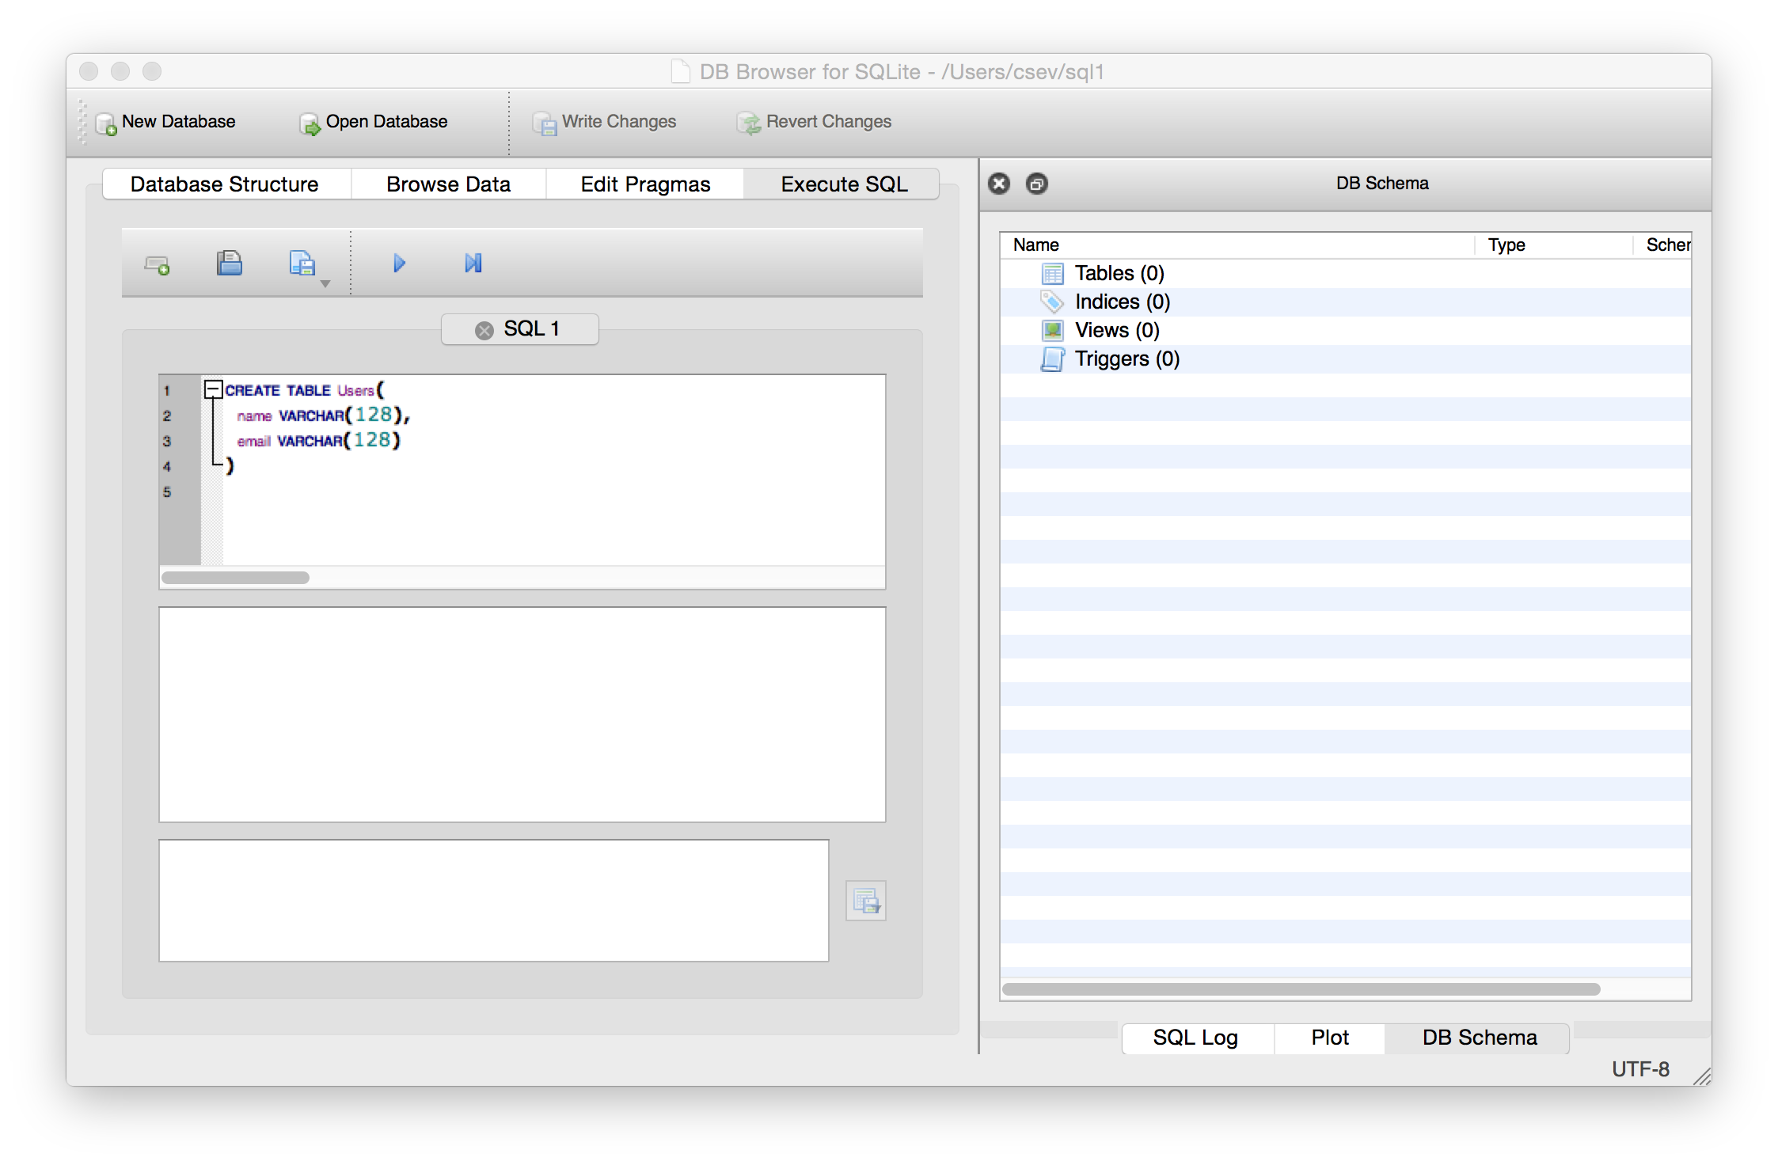
Start Simple - A Single Table
CREATE TABLE Users(
name VARCHAR(128),
email VARCHAR(128))

Slide 39
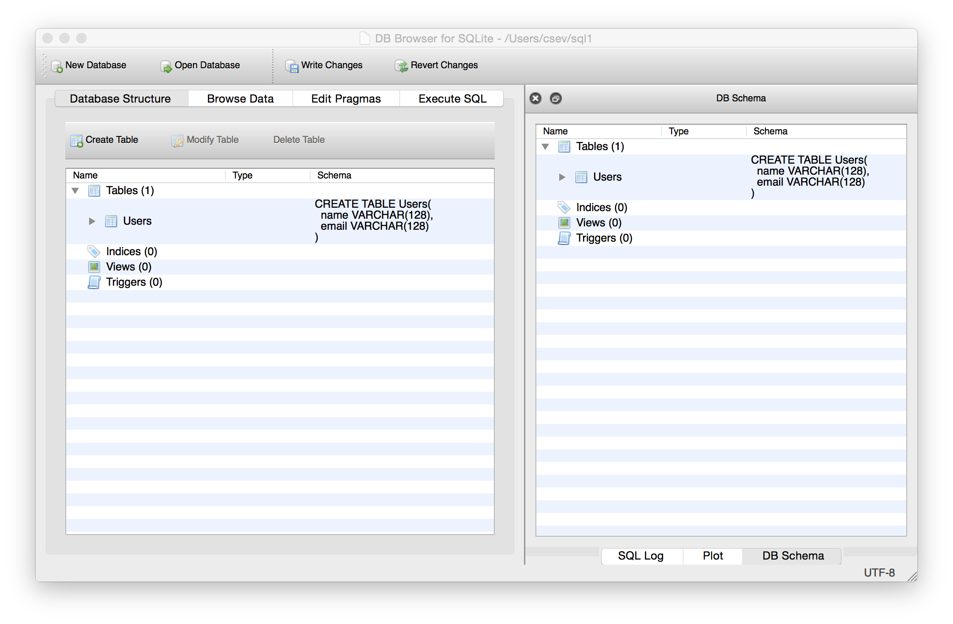

Slide 40
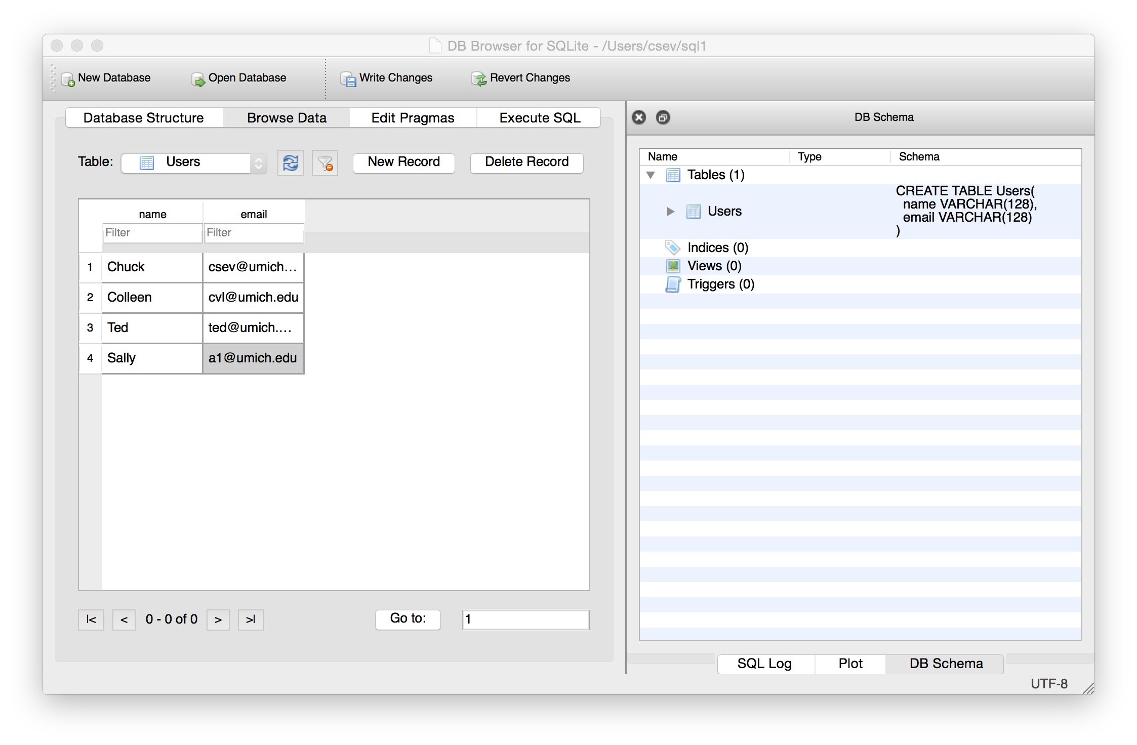
Our table with four rows

Slide 41
SQL Insert
The Insert statement inserts a row into a table
INSERT INTO Users (name, email) VALUES (’James', ’jpapa@iit.edu')

Slide 42
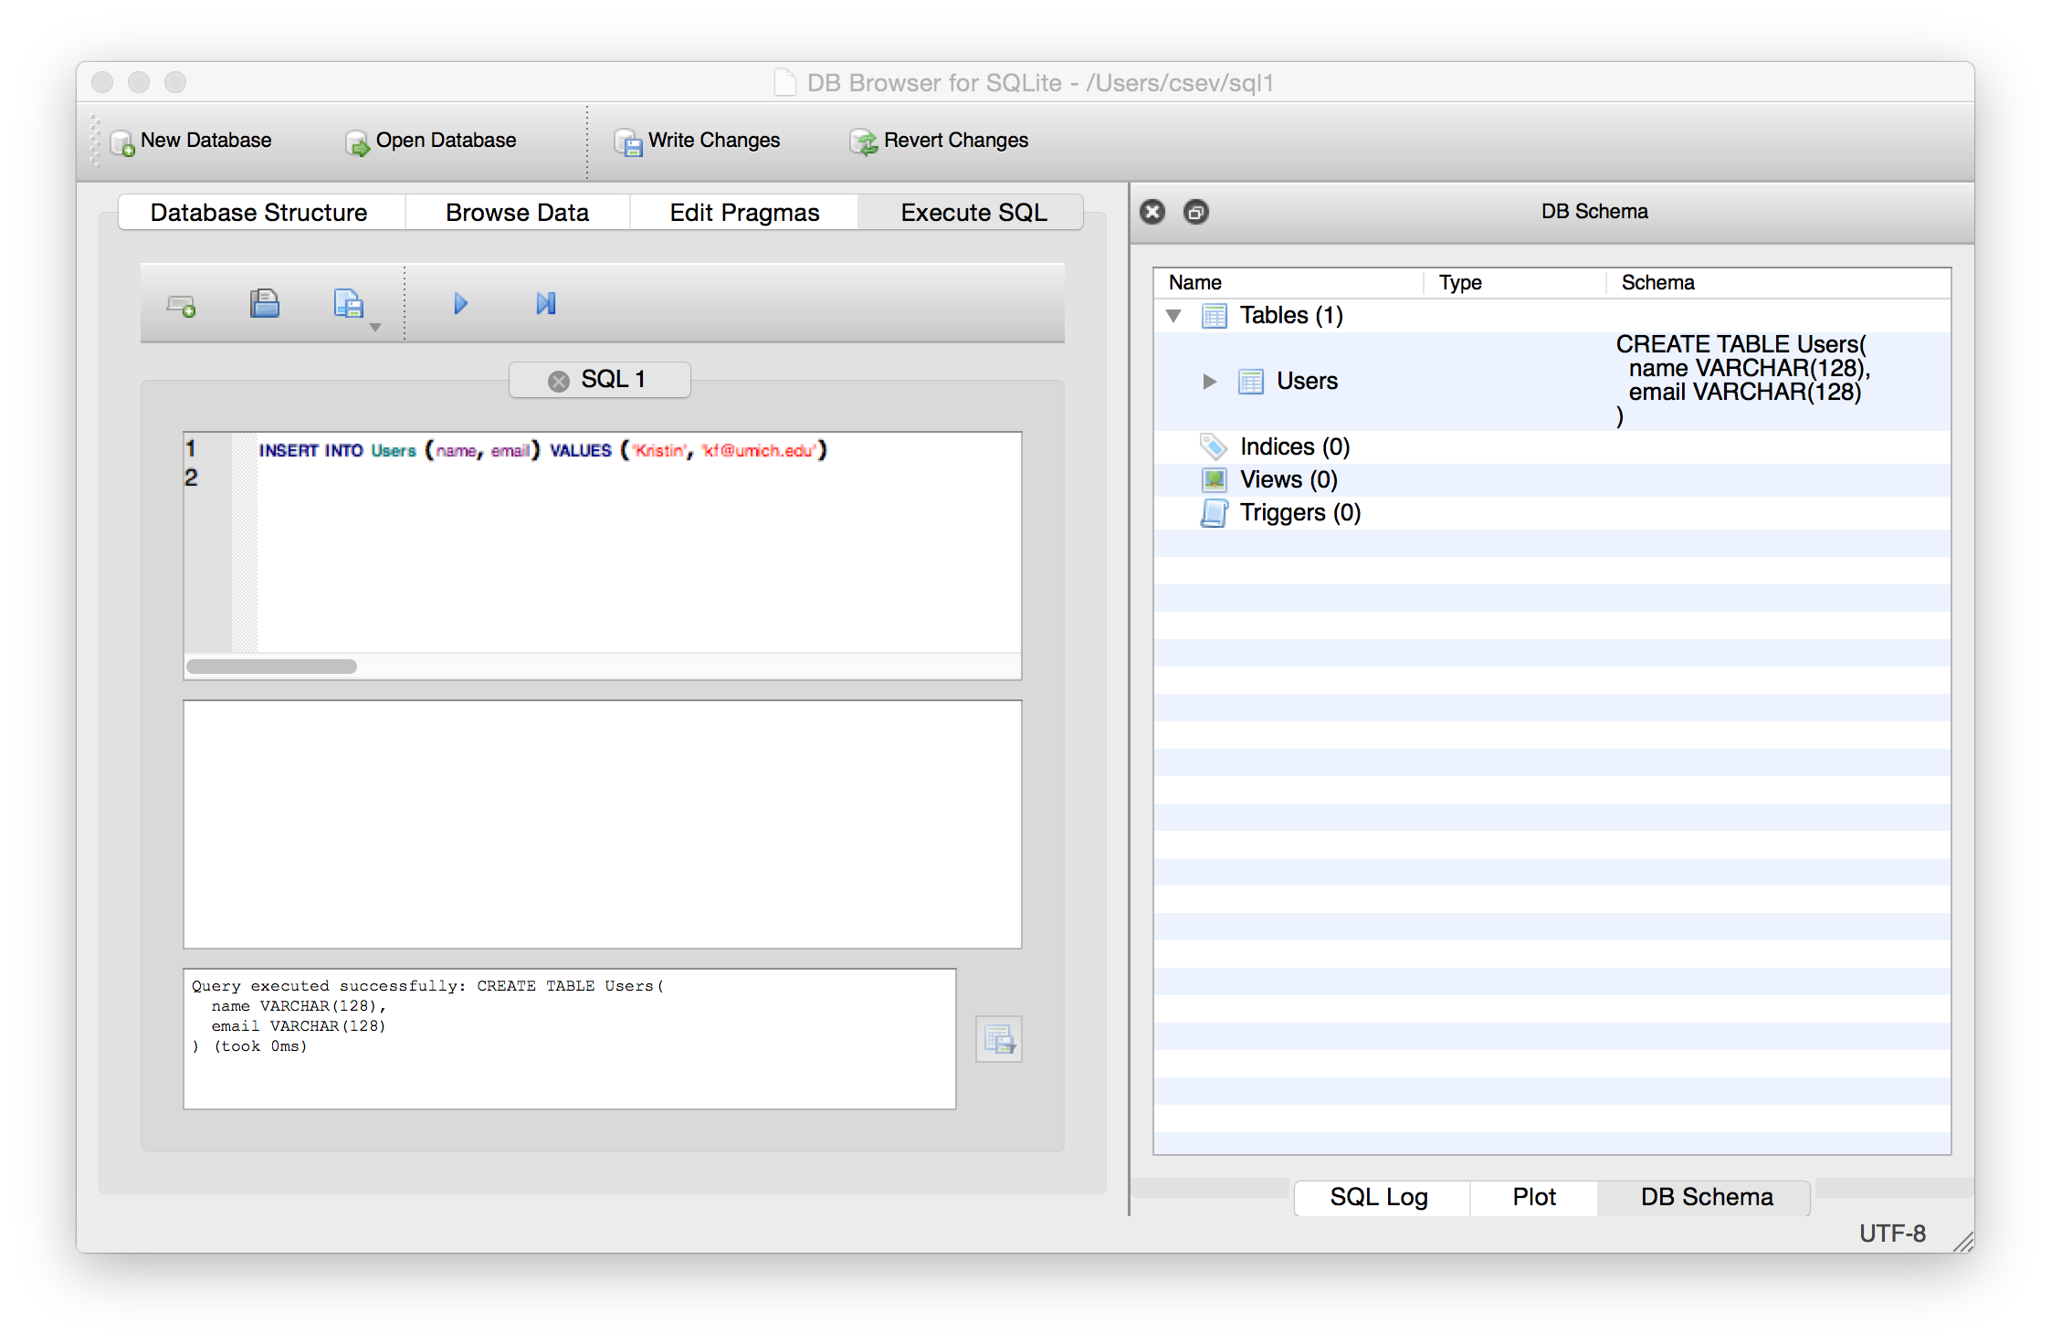

Slide 43
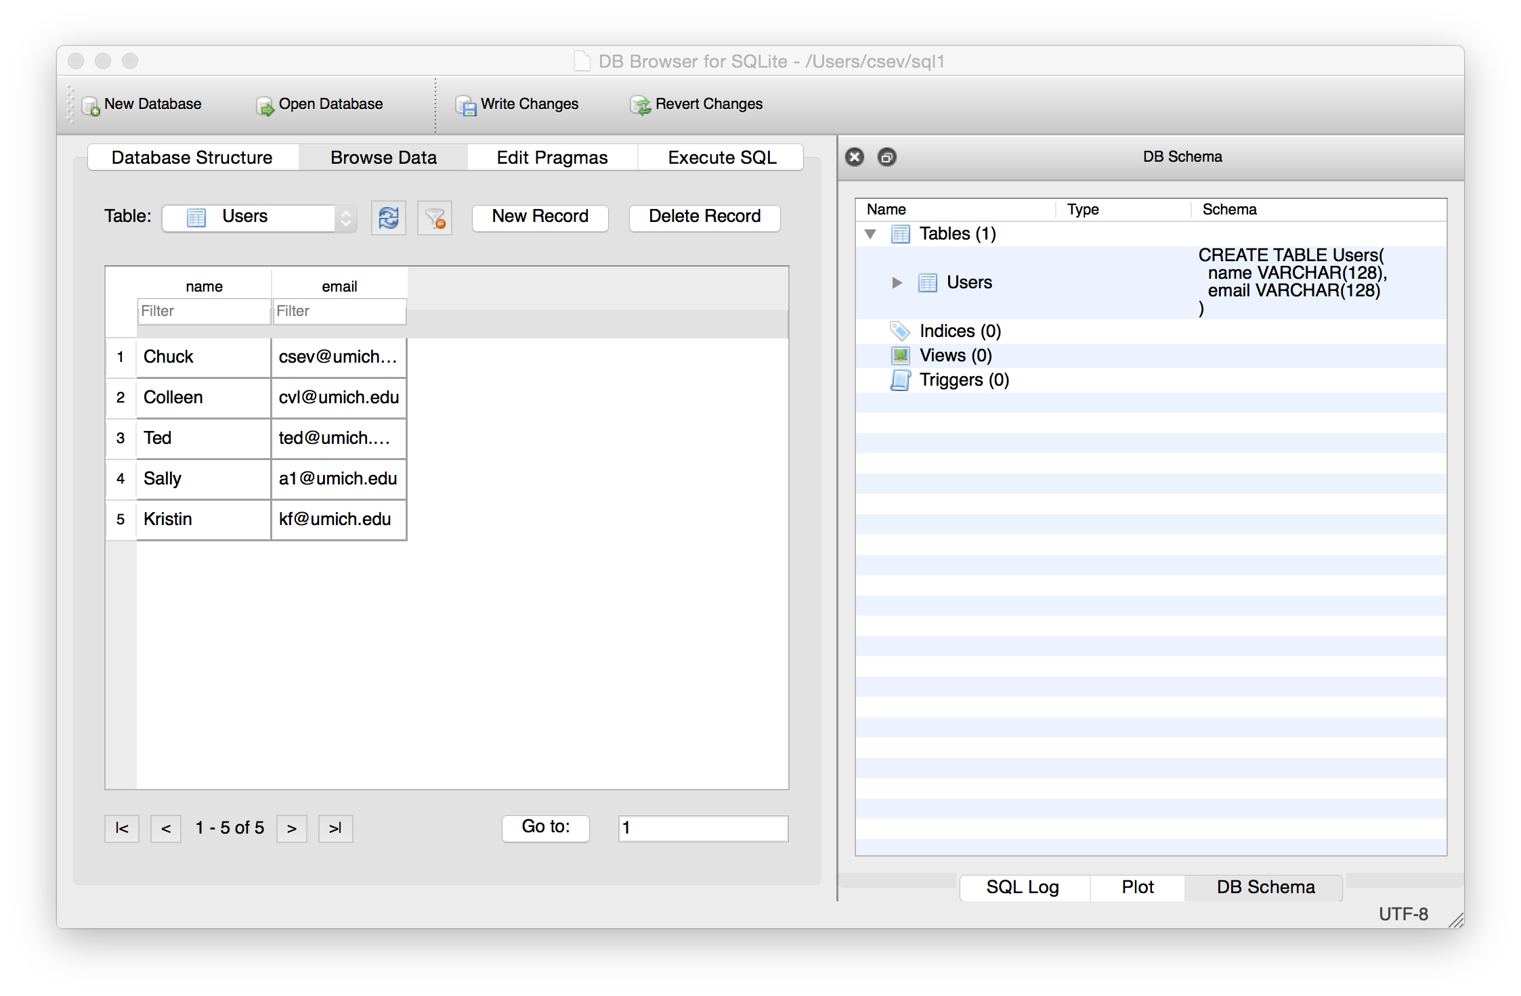


Slide 44
SQL Delete
Deletes a row in a table based on a selection criteria
DELETE FROM Users WHERE email='ted@umich.edu'

Slide 45
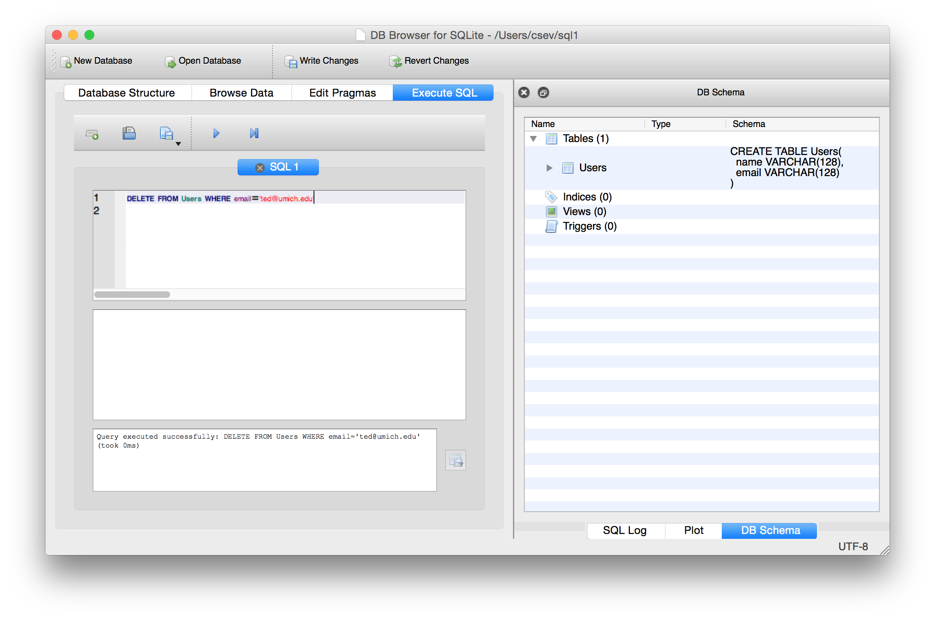

Slide 46
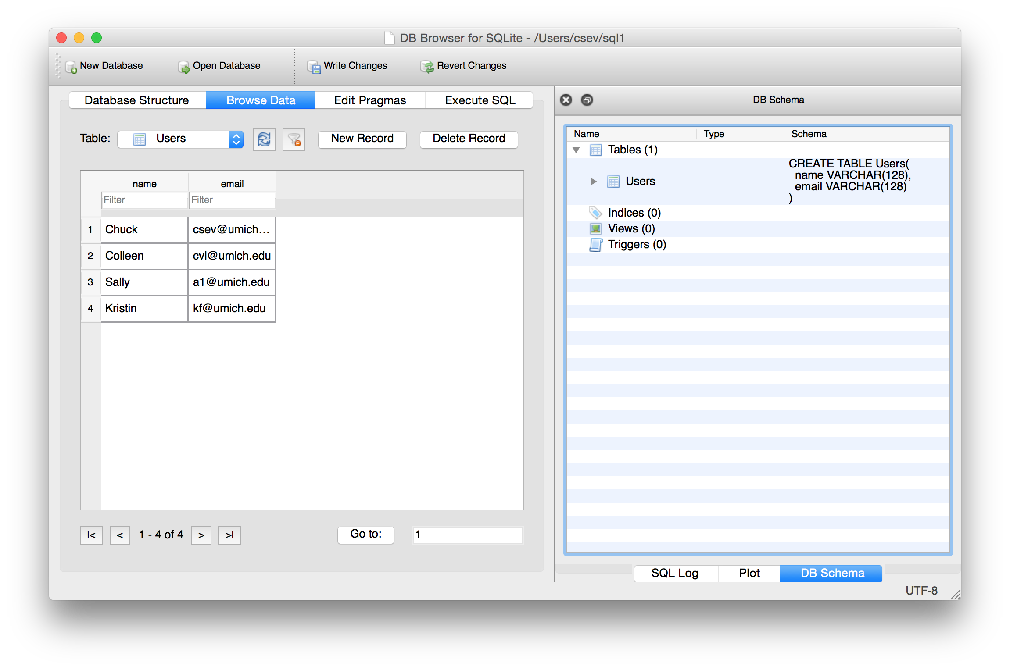

Slide 47
SQL: Update
Allows the updating of a field with a where clause
UPDATE Users SET name='Charles' WHERE email='csev@umich.edu'

Slide 48
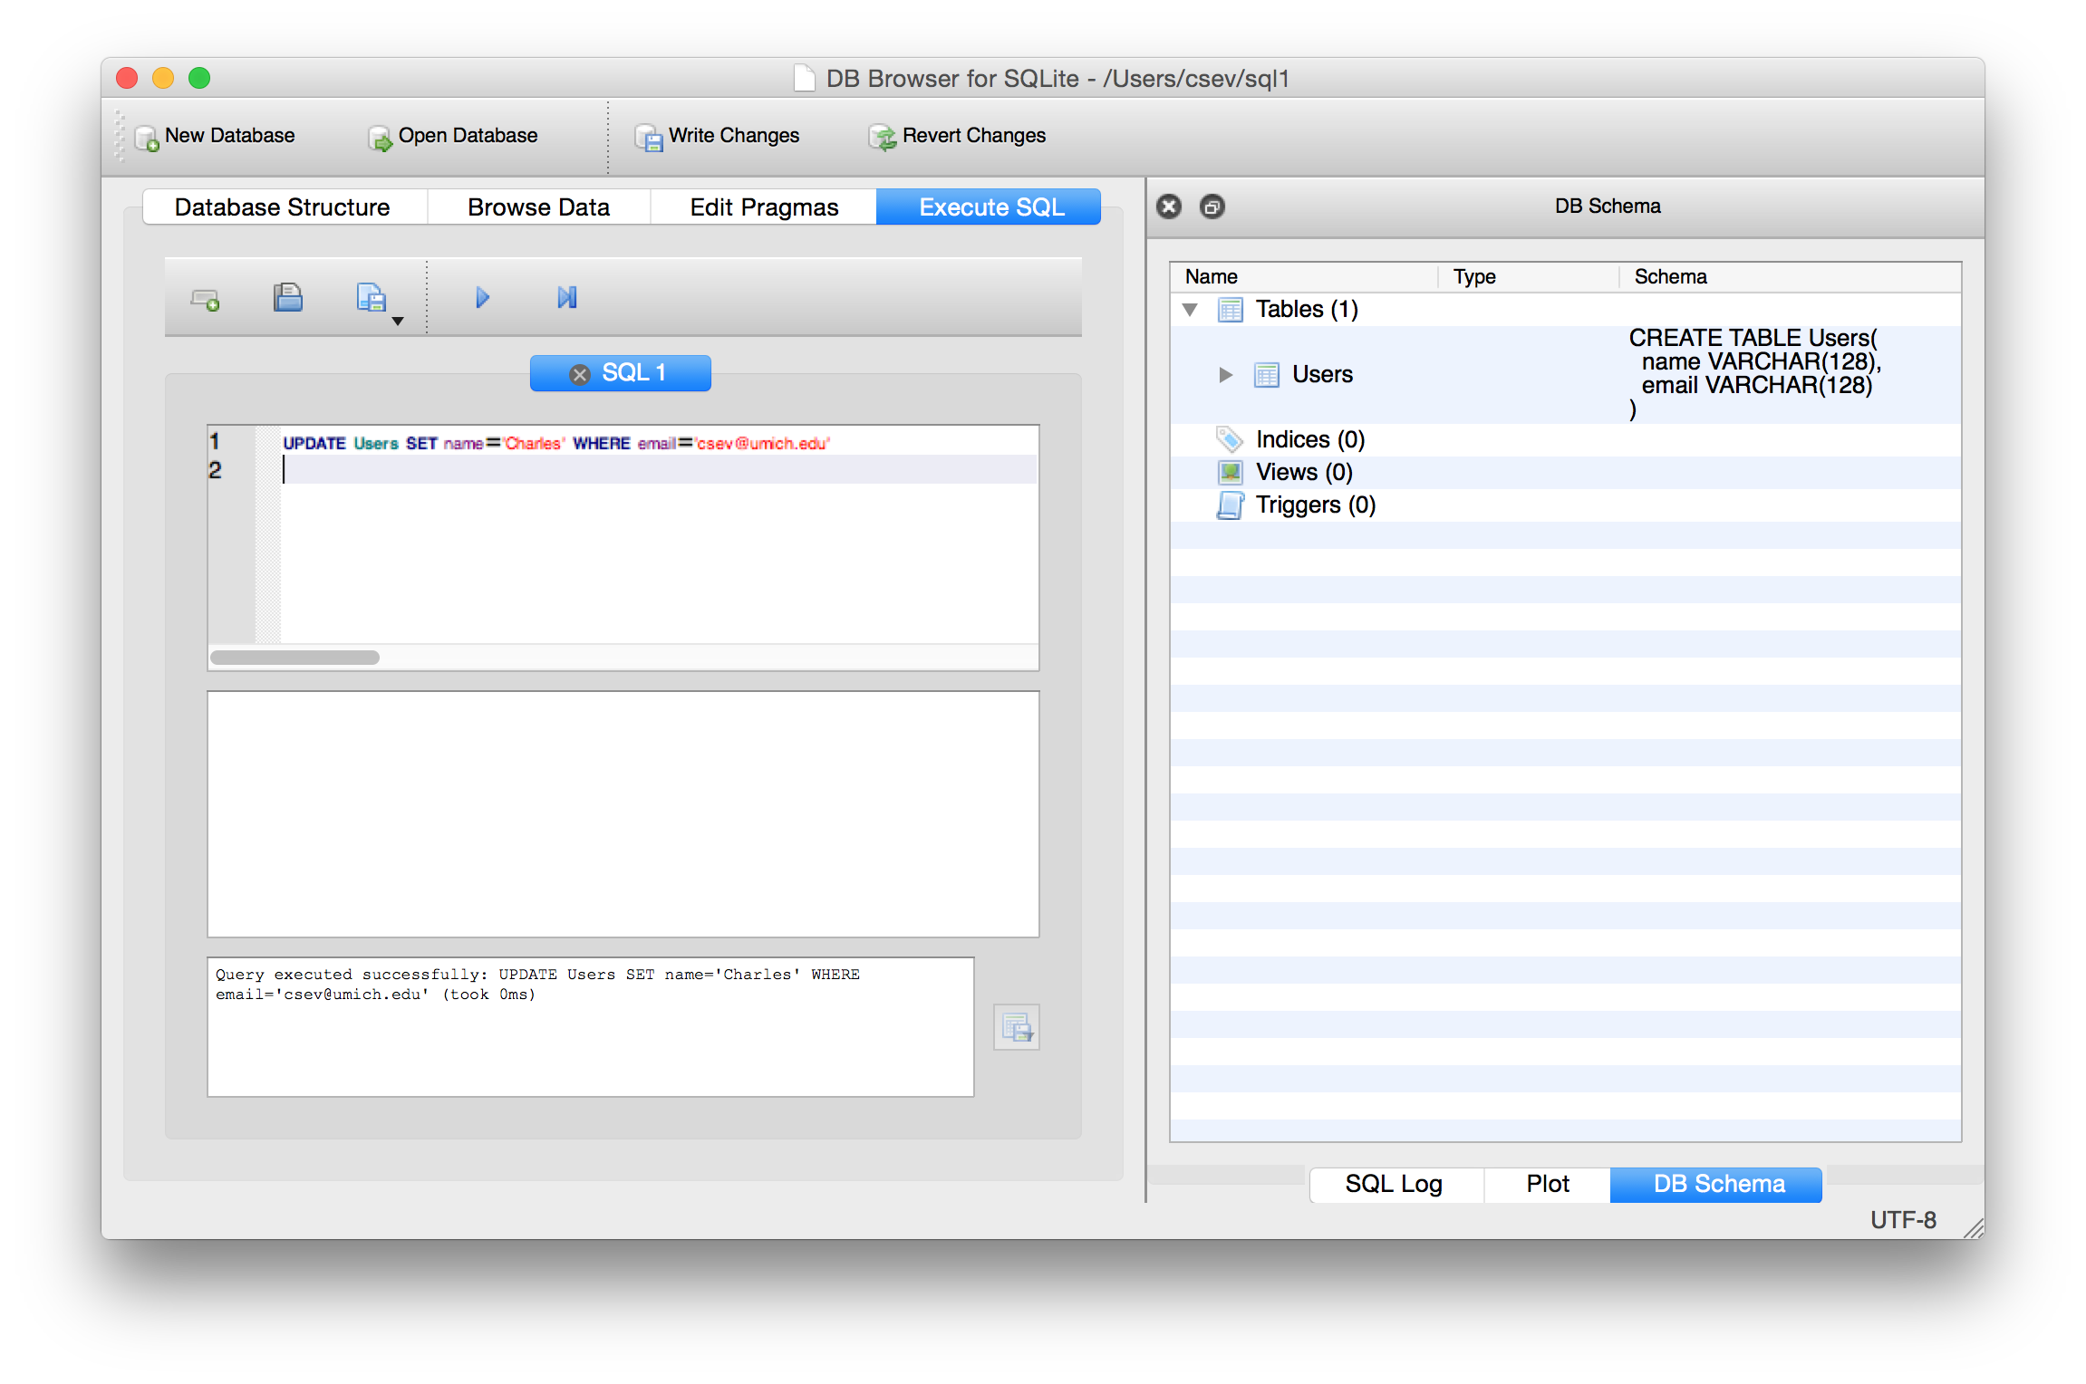

Slide 49


Slide 50
Retrieving Records: Select
The select statement retrieves a group of records - you can either retrieve all the records or a subset of the records with a WHERE clause
SELECT * FROM Users
SELECT * FROM Users WHERE email=’jpapa@iit.edu'

Slide 51
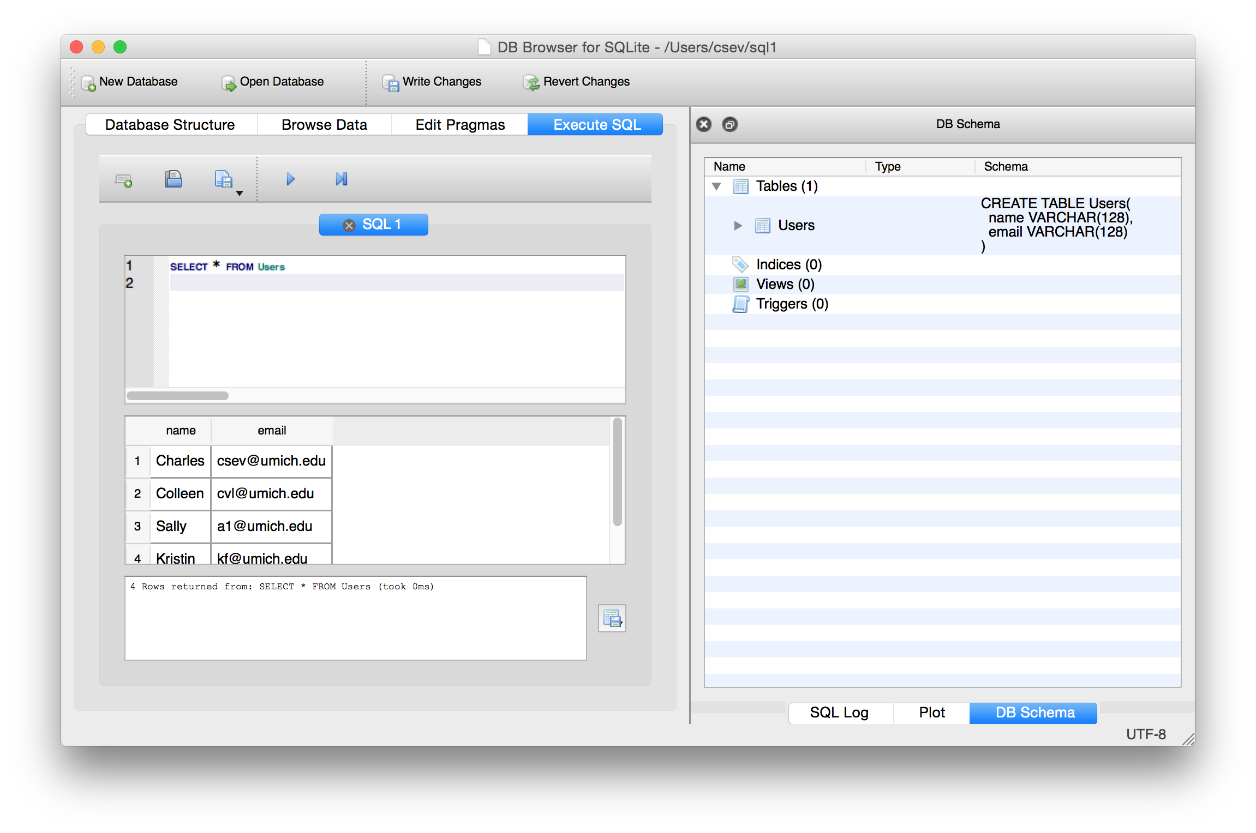

Slide 52
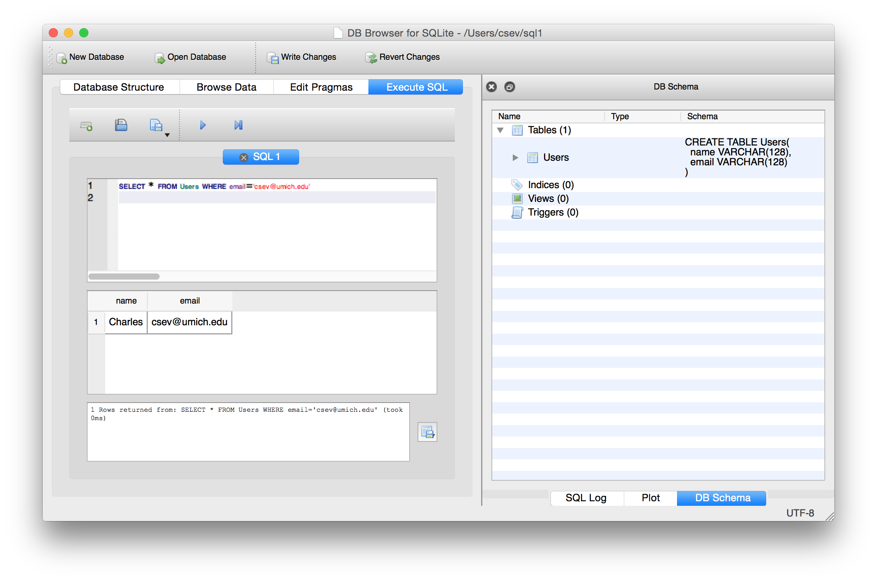

Slide 53
Sorting with ORDER BY
You can add an ORDER BY clause to SELECT statements to get the results sorted in ascending or descending order
SELECT * FROM Users ORDER BY email
SELECT * FROM Users ORDER BY name

Slide 54
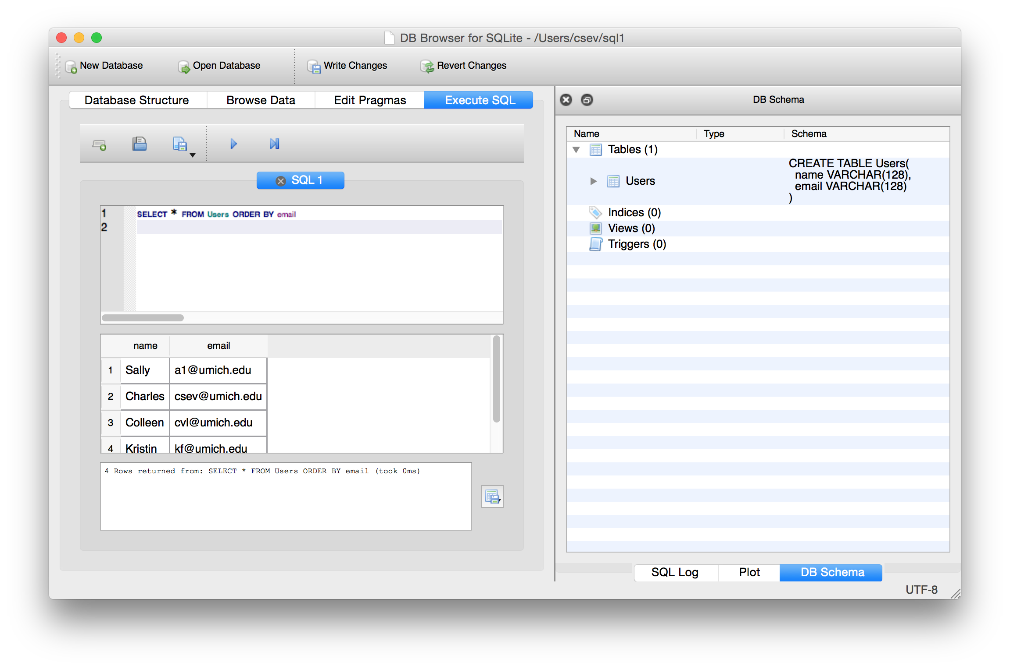

Slide 55
Resources
sqlite
www.sqlite.org
SQL
www.w3schools.com/sql
Python and sqlite3
Python reference documentation

